Slide 1

Spatial News
Localization of
incidents within a community
Callie Wentling
Professor Marco Painho
Notes:
I believe that we as citizens are a bit out of sync with our communities.
Digital connection and AI applications have, in some ways, broadened our horizons to discover new people, music, activities, and places – using previous interests to predict what we will like.
But between these global medias and the sheer scale of people in our neighborhoods, it is difficult to keep track of what is, has, and will happen in our physical surroundings.

Slide 2
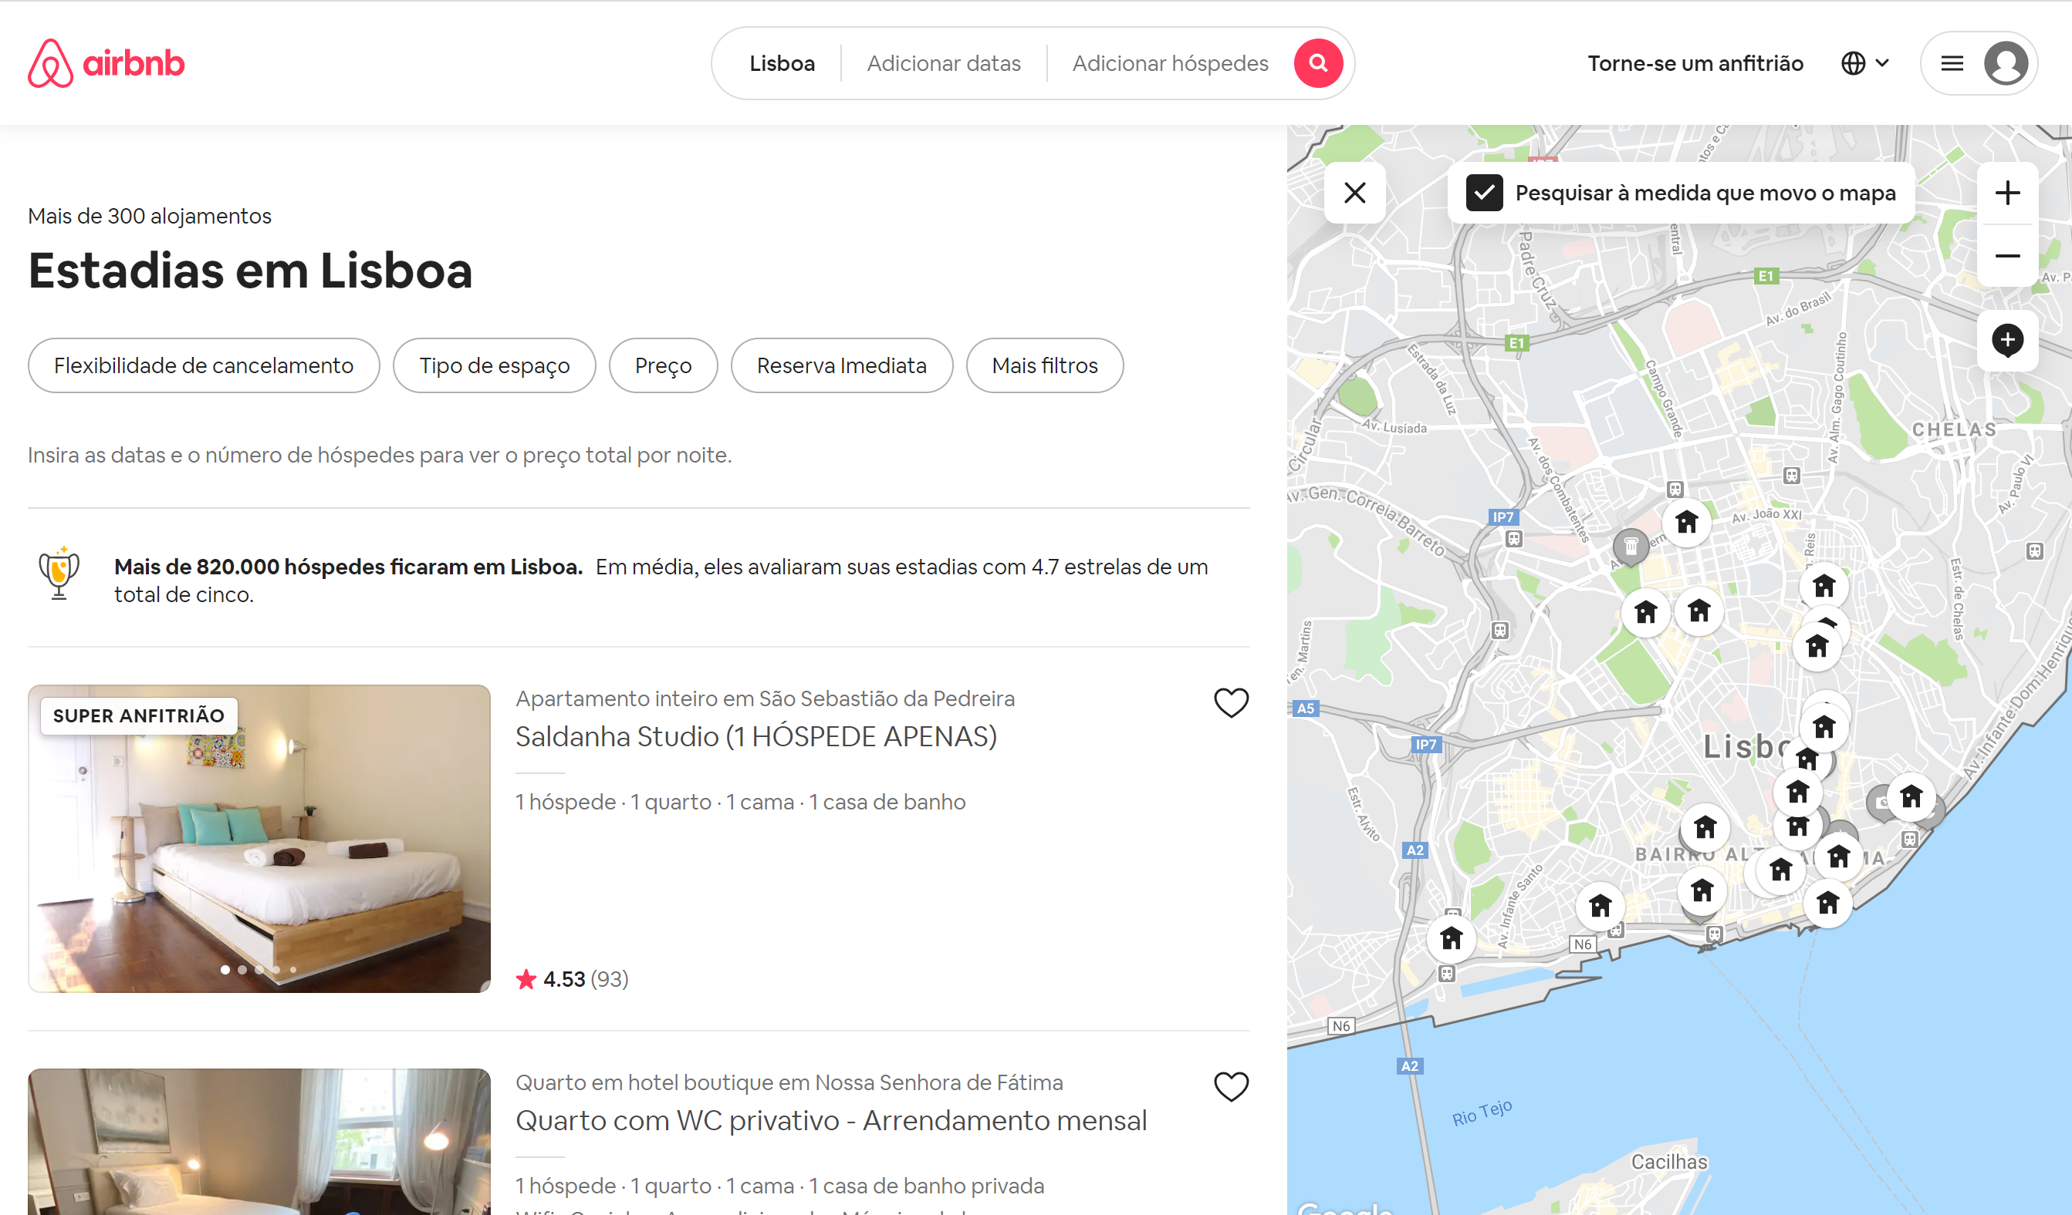
Framework: Situation
Notes:
We as digitally adept users are already trained to manipulate the spatial, temporal, and thematic attributes of databases such as AirBnB, GoogleMaps, UberEats, Glovo, Vagamundos, etc.

Slide 3
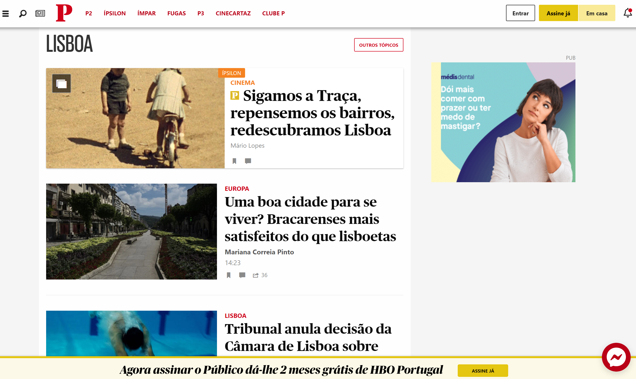
Framework: Status Quo
Notes:
This is noticeably absent from our news media. To search, we are provided only keywords or general categories. We cannot see distributions of news incidents for a given timeframe, and rarely is there even a context map to situate the potentially nuanced contents of a particular news story.
I propose to create a proof of concept webapp that tackles this void. The goal is to select a study area (Lisbon) and map the contents of news for a given study period, news source, and section (local). To do this, a suite of tools (input and manipulation) must be developed to investigate if this kind of product can provide additional citizen insight, stronger research resources, and/or official monitoring of an area to substantiate further development.
Because it is at a sub-city level, automatic extraction will likely not be appropriate to define location in many cases, and I anticipate that many areas will require custom definitions.

Slide 4
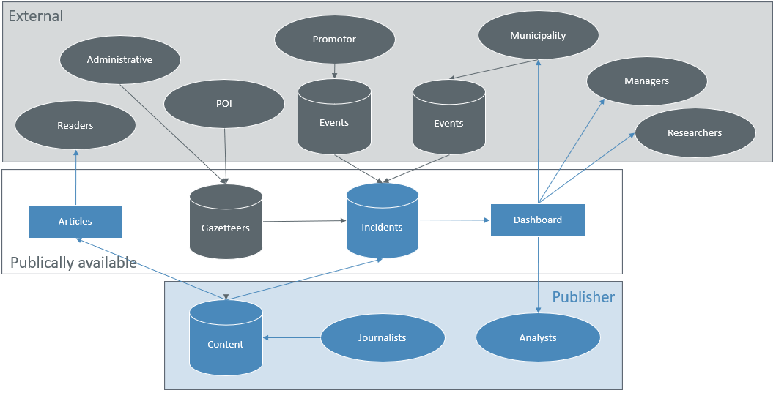
Framework: Data Flow

Slide 5
Hypothesis
Is there value in integrating a spatial component to news databases?
The association of place will provide a new dimension of understanding of incident distribution at a local level.
Publishers integrating spatial news may provide an improved user experience to readers, researchers, and monitors.

Slide 6
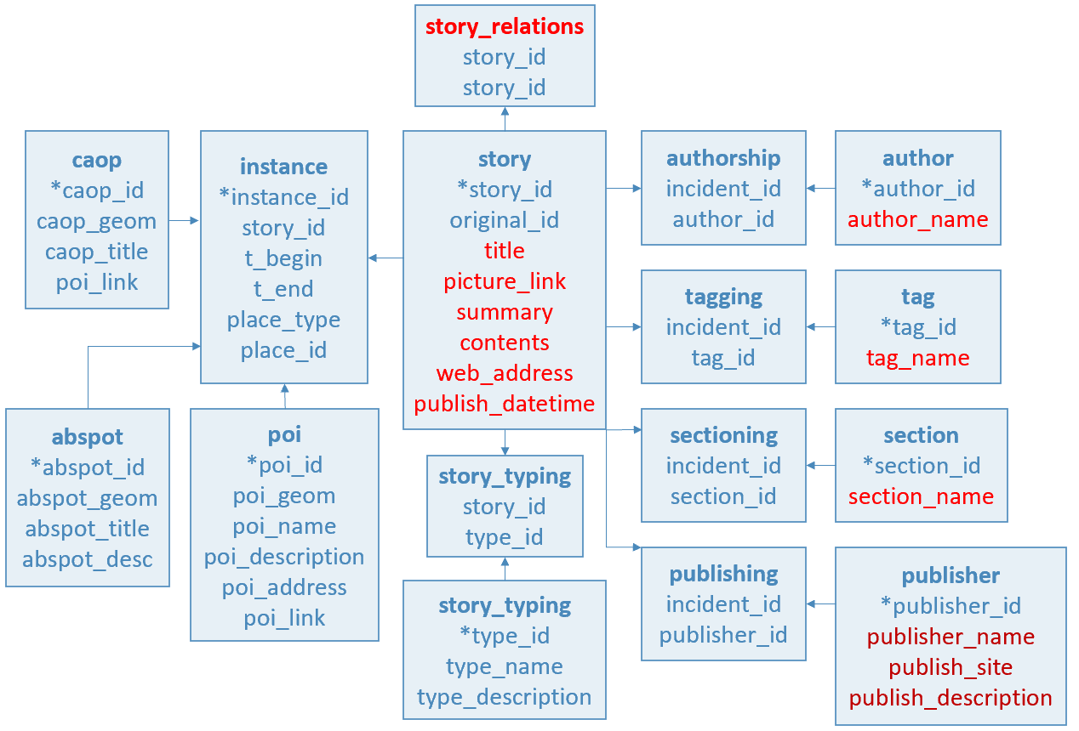
Objectives: Spatial DB of Incidents
Notes:
This is the current working data model. The items in red are expected to be provided by the news data sources.

Slide 7
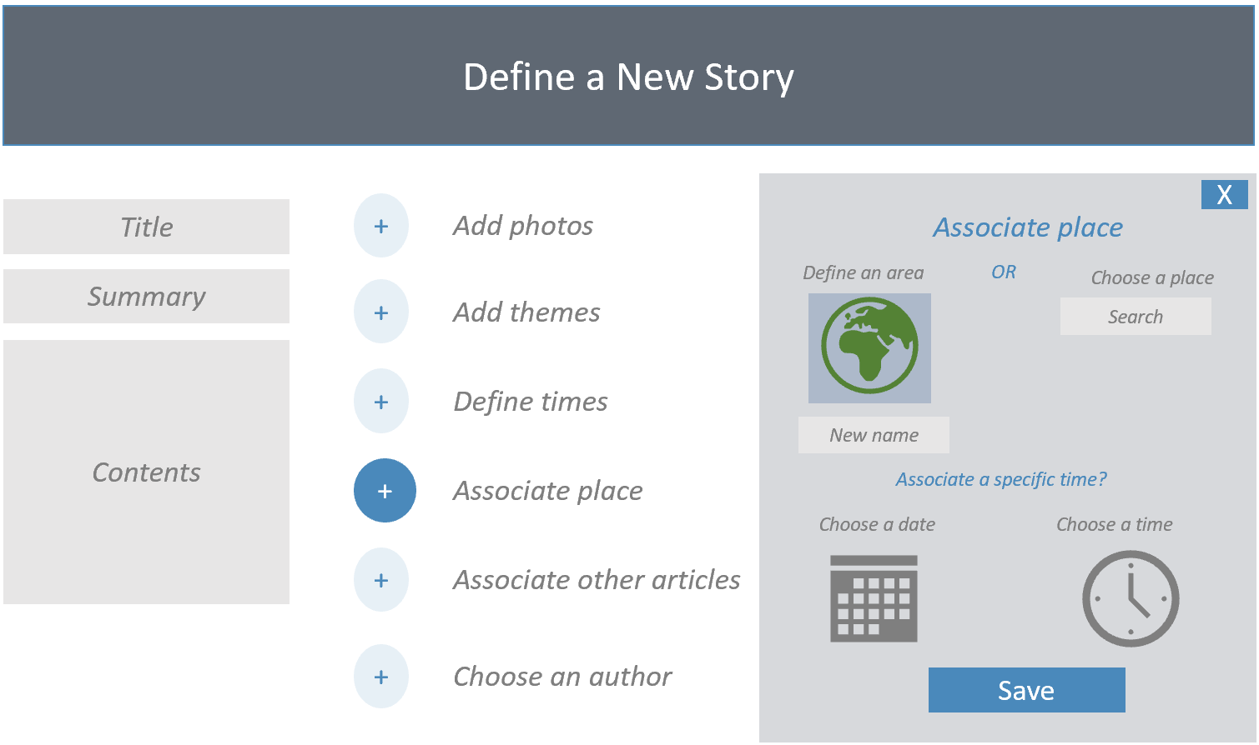
Objectives: Publisher Input Tool

Slide 8
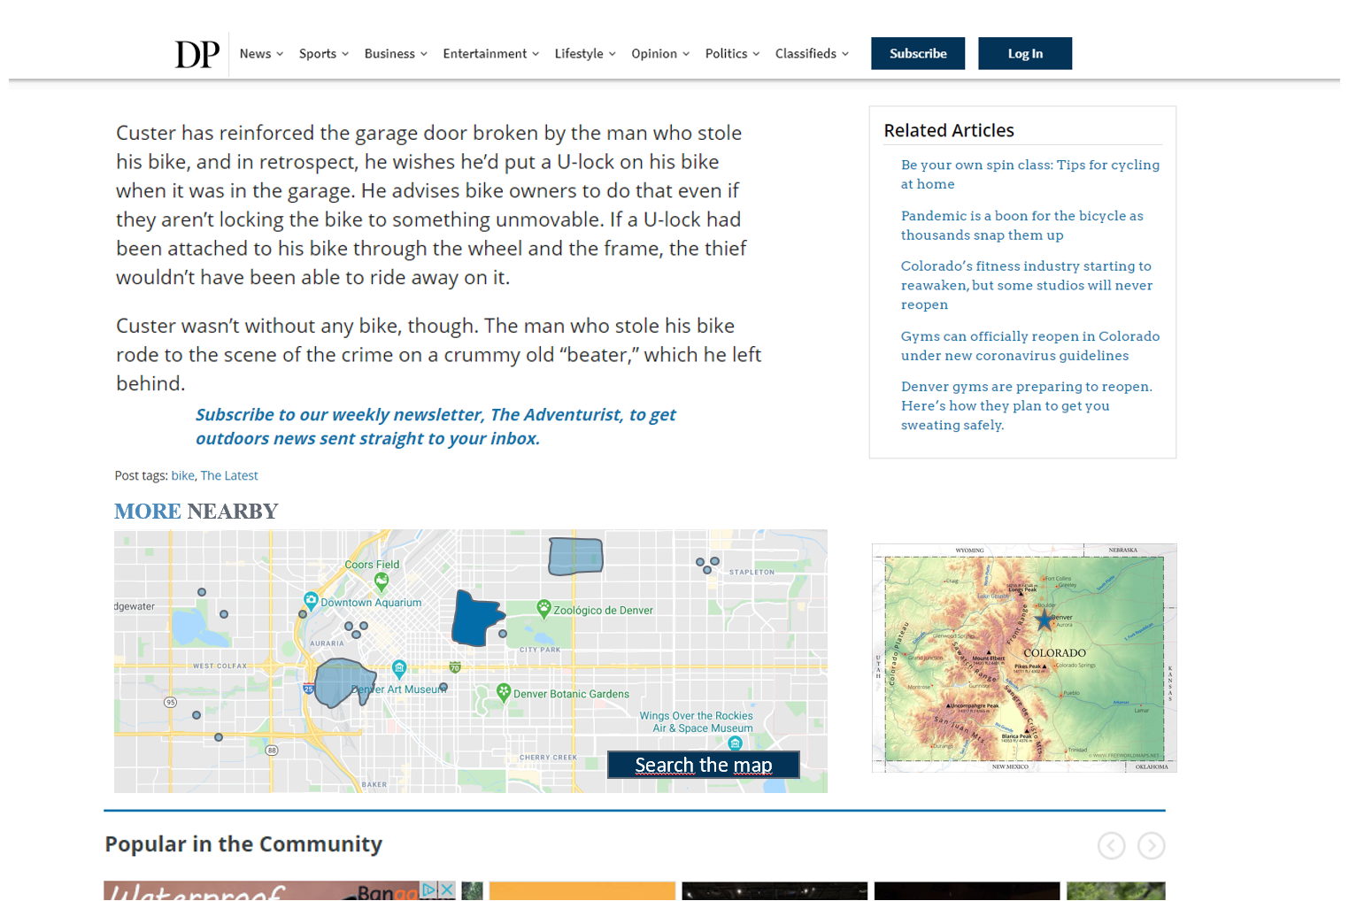
Objectives: Context Map

Slide 9
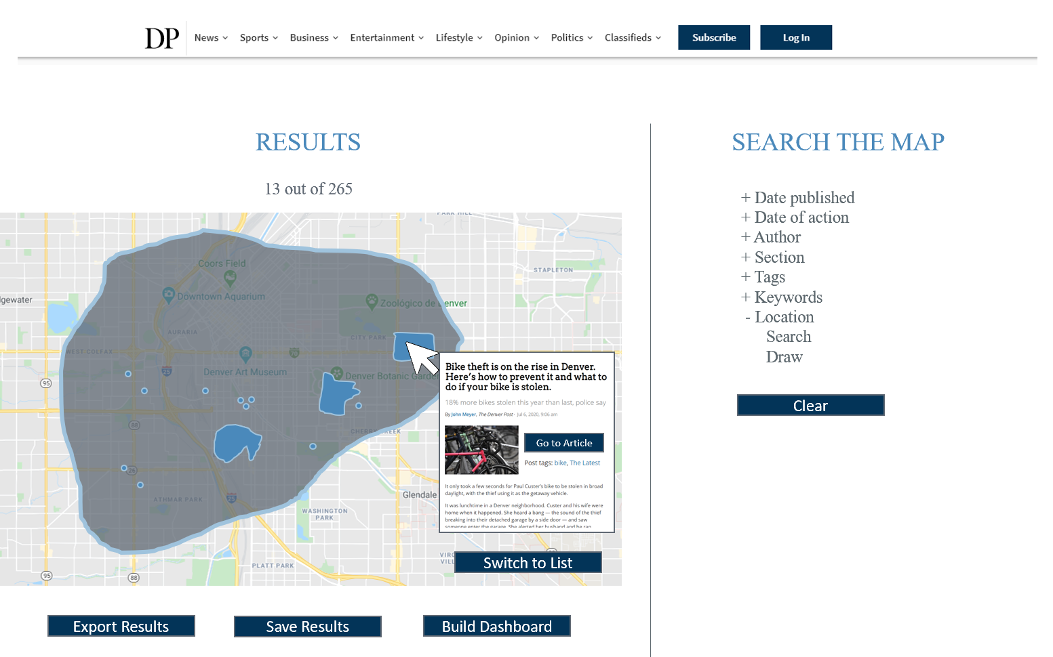
Objectives: Search Tool

Slide 10
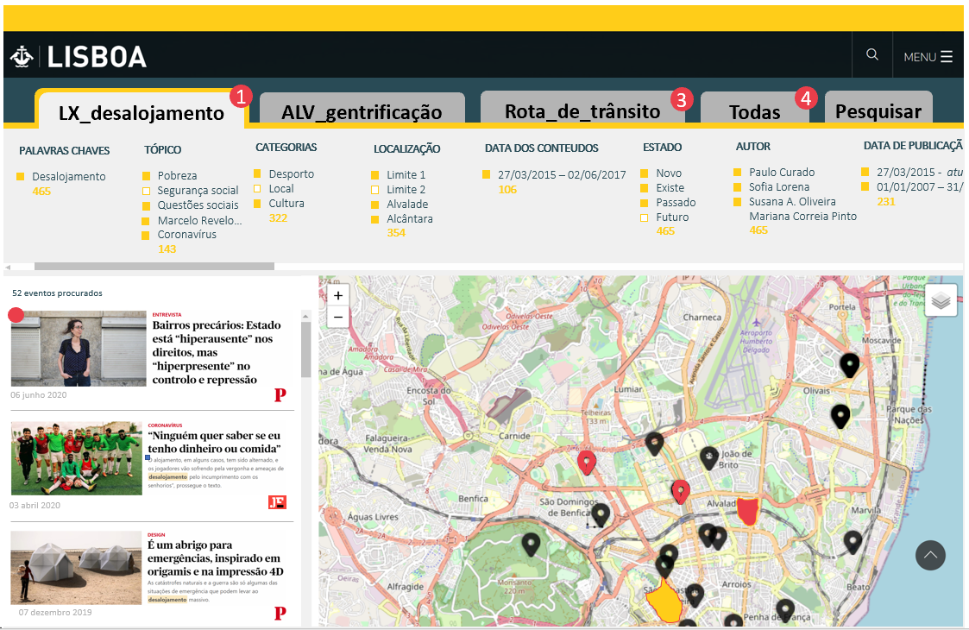
Objectives: Dashboard Tool

Slide 11
Methodology
Literature/resource review
Specification of products
Establish the development environment
Request/receive data
Establish incident DB
Load gazetteers, POI, admin boundaries
Develop and test tools
Translate and load content options
Migrate site to the server
Test among stakeholders
Document results and plan future development
Notes:
Incident DB: multiple spatial data types (point and polygons), multiple language options
Develop and test Input, Search, Context, and Dashboard tools

Slide 12

Thank you!
Discussion
Address: Campus de Campolide, 1070-312 Lisboa, Portugal
Tel: +351 213 828 610 | Fax: +351 213 828 611

Slide 13
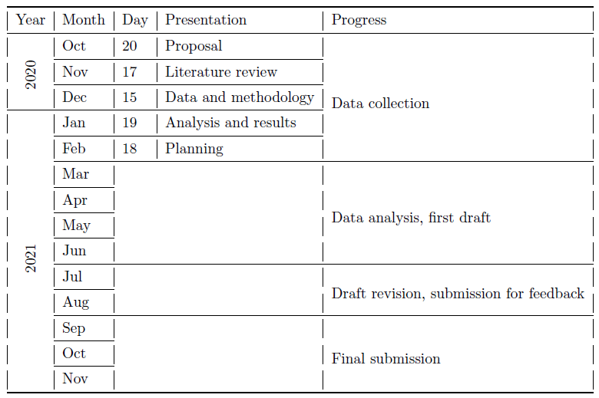
Timeline

Slide 14
Objectives: Personal development
Planning and execution of GIS “product”
Creation and maintenance of a GS DB
Programming of UIs
Leveraging OS programs and tools
Incorporation of multi-lingual functionality
Collaboration with stakeholders
Development of OS tools
Provisioning a base product for future dev.

Slide 15
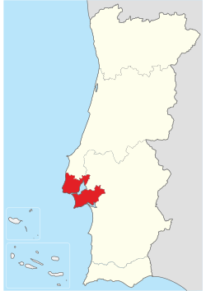
Objectives: Features
EN
PT
English and Portuguese web-app languages
NUTSII Lisboa region
Point and polygon area definitions
NUTS II

Slide 16
Organization
1. Introduction
(a) Context
i. Smart cities [1, 2]
ii. News
(b) Hypothesis
(c) Objectives
2. Literature review
(a) Web tools for news
i. News search tools
A. Portuguese based publication (ex: Publico) [3]
B. US based publication (ex: The Denver Post) [4]
C. Good example
D. Bad example
ii. Automatic extraction of place in news
A. GDELT
iii. WebGIS as a search tool
A. AirBnB
B. UberEats
C. Idealistia
D. CML
E. Facebook events
iv. Open Source
A. Denition of terms
B. Licensing options
v. Open/free formats in WebSIG
(b) GIS on the Web
i. Open/free code solutions
A. QGIS cloud
B. ArcGIS Server
C. Lizmap
D. Leaet
E. MapServer
F. Geomajas
ii. Commercial solutions
iii. Design [5{14]
iv. Build
A. Hosting
B. Front end: Leaet, openlayers, HTML
C. Backend: Python (shpaely, geopandas, gdal, pyproj), geodjango, geoserver
D. Database: PostGIS, PostgreSQL
E. Data prep: QGIS, ArcMap
(c) Fundamental concepts
i. Map algebra
ii. Map t
iii. Geotagging data [15, 16]
iv. Application of gazetteers [17{20]
v. Internalization and localization
(d) Summary
3. Study area
(a) Portugal
i. Demographics
ii. Habitual news sources
A. Facebook
B. Newspapers
C. Television
iii. public participation platforms
A. OLX
B. Na Minha Rua
4. Methodology
(a) Data
i. Sources
ii. Categorization of data
iii. Preprocessing
(b) Methods
i. Data model
ii. WebGIS architecture
iii. WebGIS application
5. Results
(a) Resulting tools
(b) Spatial distribution of news in study area
(c) Comparison to traditional methods/automatic extraction
6. Conclusion
(a) Challenges/shortcomings
(b) Future development
(c) Summary
Notes:
Incident DB: multiple spatial data types (point and polygons), multiple language options
Develop and test Input, Search, Context, and Dashboard tools

Slide 17
References
[1] Tiago H Moreira De Oliveira and Marco Painho. Open Geospatial Data Contribution Towards Sentiment Analysis Within the Human Dimension of Smart Cities. In A Mobasheri, editor, Open Source Geospatial Science for Urban Sudies., pages 75{95. Springer International Publishing, 2021.
[2] Prof Stephane Roche. UrbComp2012 Paper10.pdf. 2012.
[3] PUBLICO, 2020.
[4] The Denver Post, 2020.
[5] Fabio Parasecoli and Mateusz Halawa. Rethinking the global table. In May Rosenthal and Catherine Flood, editors, Food: Bigger than the plate, pages 80{89. Victoria and Albert Museum, London, 2019.
[6] Eric Fisher. Making the most detailed tweet map ever, dec 2014.
[7] Ben Shneiderman. Data Visualization's Breakthrough Moment in the COVID-19 Crisis, apr 2020.
[8] Elijah Meeks. 2019 Was the Year Data Visualization Hit the Mainstream, dec 2019.
[9] Ben Shneiderman. The Eyes Have It: A Task by Data Type Taxonomy for Information Visualizations. Technical report, University of Maryland, College Park, jul 1996.
[10] Yixuan Zhang, Kartik Chanana, and Cody Dunne. IDMVis: Temporal Event Sequence Visualization for Type 1 Diabetes Treatment Decision Support. IEEE Transactions on Visualization and Computer Graphics, 25(1):512{522, 2019.
[11] Michelle Rial. Am I overthinking this? Over-answers life's questions in 101 charts. Chronicle Books, San Francisco, United Sates, aug 2019.
[12] C Giovando, N Vanraes, I Kanellopoulos, and G Saio. The nature-GIS portal: a gateway for accessing geospatial data on protected areas and nature preservation in Europe. Technical report, Warsaw, Poland, jun 2004.
[13] Katy Borner, Andreas Bueckle, and Michael Ginda. Data visualization literacy: Denitions, conceptual frameworks, exercises, and assessments. PNAS, 116(6):1857{1864, feb 2019.
[14] Alberto Cairo. The truthful art: data, charts, and maps for communication. New Riders, San Francisco, 2016.
[15] Dean Hintz and Craig Hantke. How government agencies are integrating & delivering data for emergency response, 2020.
[16] Artur Jorge Abreu Varanda. Project "ORACULO": Extracting events from news streams and mining their spatiotemporal patterns to support UN operations in the Central African Republic, 2020.
[17] Sabine Witschas. Cross-border mapping-Geodata and Geonames. Technical report, 2004.
[18] NGA: GNS Home.
[19] Alexandria Digital Library Gazetteer | UCSB Library, 2019. [20] Richard Nordquist. Exonyms and Endonyms, jan 2018.
[21] Kostas Kampourakis. Television and the genetic imaginary. 2020.
[22] Marco Painho and Isabel Pina. The invisible cities-can PPGIS connect citizens to urban policies? Revista Internacional de Ciencia y Tecnologa de la Informacion Geograca, 1(13):1{4, 2013.
[23] The Armed Conict Location & Event Data Project, 2020.
[24] Matt Makai. Deployment.
[25] OpenStreetMap.
[26] Claudia Henriques, Pedro Marques Gomes, and Slvia Marques Torres. OS MEDIA NO PORTUGAL CONTEMPOR^ANEO: da ditadura a democ. Imprensa da Universidade de Coimbra, 35:19(2), 2019.
[27] Jerry Low. How to Host Your Own Website: Step-by-step Tutorial, sep 2020.
[28] Ramiz Sami. Tools I recommend for building Geospatial Web Applications | by Ramiz Sami | The Startup | Medium, oct 2019.
[29] Ulrich Drepper, Jim Meyering, Francois Pinard, and Bruno Haible. GNU gettext tools, version 0.21. Technical report, Free Software Foundation, Inc., jul 2020.
[30] Albert Acedo, Tiago Oliveira, Mijail Naranjo-Zolotov, and Marco Painho. Place and city: toward a geography of engagement. Heliyon, 5(8):e02261, 2019.
[31] Karina Popova. Politicization of non-political events: A Geospatial Analysis of Twitter Content During The 2014 FIFA World Cup. 2015.
[32] Stig Hjarvard. The mediatization of culture and society. 2013.
[33] Devanjan Bhattacharya and Marco Painho. Location intelligence for augmented smart cities integrating sensor web and spatial data infrastructure (SmaCiSENS). GISTAM 2018 - Proceedings of the 4th International Conference on Geographical Information Systems Theory, Applications and Management, 2018-March(Gistam):282{289, 2018.
[34] Mark Fisher. Capitalist Realism: Is there no alternative? zero books, 2019.
Notes:
Incident DB: multiple spatial data types (point and polygons), multiple language options
Develop and test Input, Search, Context, and Dashboard tools

